Slide 1
Performance management
Software Engineering, August 2019

Slide 2
Context
There have been changes to performance management across KOKO
Performance review cycle will be biannual instead of quarterly
OKR setting is not mandatory for all employees
Performance evaluation is based evaluation of the demonstrated competencies expected for your role

Slide 3
Core competencies
What do we expect from engineers?

Slide 4
Core competencies
The following five core competencies have been defined as key ingredients of successful performance, and will be evaluated during performance reviews
Work Product
Project Management
Technical Leadership
Communication
Management of Self & Others
The expectations are defined for each grade and are cumulative through the grades

Slide 5
Supporting materials
Supporting the competencies are:
Role profiles, defining the expectations at each grade, in terms of responsibility levels according to a KOKO-wide matrix, and a role description
Knowledge, skills and technology definitions that are relevant to KOKO for engineers, which will be updated as KOKO’s technology grows into new areas
These documents support understanding of the competencies at each grade, as well as personal learning and promotion goal discussions

Slide 6
Evaluation process
How will we evaluate software engineers

Slide 7
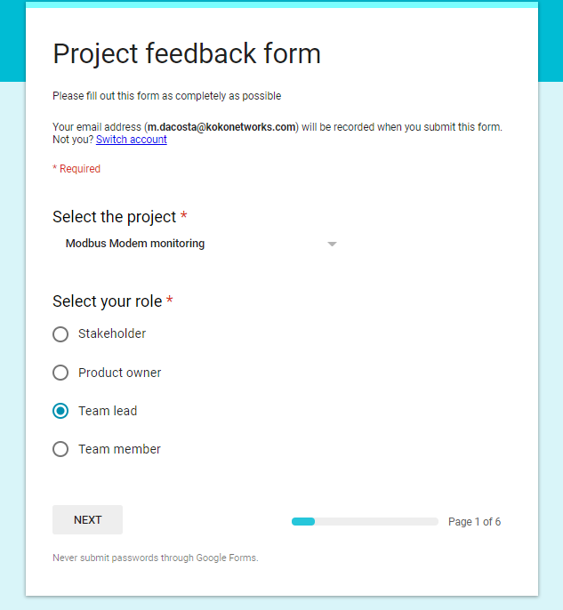
Project feedback
Our recent change to organise work into formal projects allows for better feedback to be collected
After a project completes, we will collect feedback from
Stakeholders
Product owners
Team leads
Team members

Slide 8
Performance reviews
At the end of the review cycle, performance reviews will be conducted as usual by your line manager, but against the five core competencies
The process will follow the same framework as we do currently
Self assessment
Line manager assessment
Scoring using same scale: 1 (unsatisfactory) to 5 (exceptional)
Project review feedback will be made available to line managers to support evaluation against the competencies and values

Slide 9
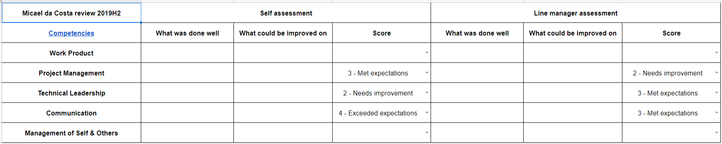
Example review scorecard
Note: format is a draft for illustration and will be incorporated into Namely
Engineer reviews own project performance against competencies to document successes and improvement areas
Manager compares engineer self-assessment, face-to-face check-in notes, and project feedback data to synthesise own view, and score against competencies

Slide 10
Note on scoring
With respect to the scoring of the competencies, the following meanings apply
1 - Unsatisfactory: Fails to adequately demonstrate most of the expected behaviours
2 - Needs improvement: Does not adequately demonstrate some of the expected behaviours
3 - Met Expectations: Successfully demonstrates all of the expected behaviours
4 - Exceeds Expectations: Demonstrates all, and exceeds some of the expected behaviours
5 - Exceptional: Exceeds all of the expected behaviours

